Slide 1

Ball Buddy
presented by : Abdulhadi Altamaimi, Zachary Chaffin, Hyejun Park, Christopher Sydnor, Bryce Vida

Slide 2
Outline
Introduction
The Current Ball Buddy
Alternatives
Future Work

Slide 3
Introduction
Ball Buddy is an aging in place solution in development by students at West Virginia University (WVU). It is a companion robot that features several functions that provides mental support for those that may experience lonliness in their daily lives.
Benjamin M. Statler College of Engineering and Mineral Resources

Slide 4
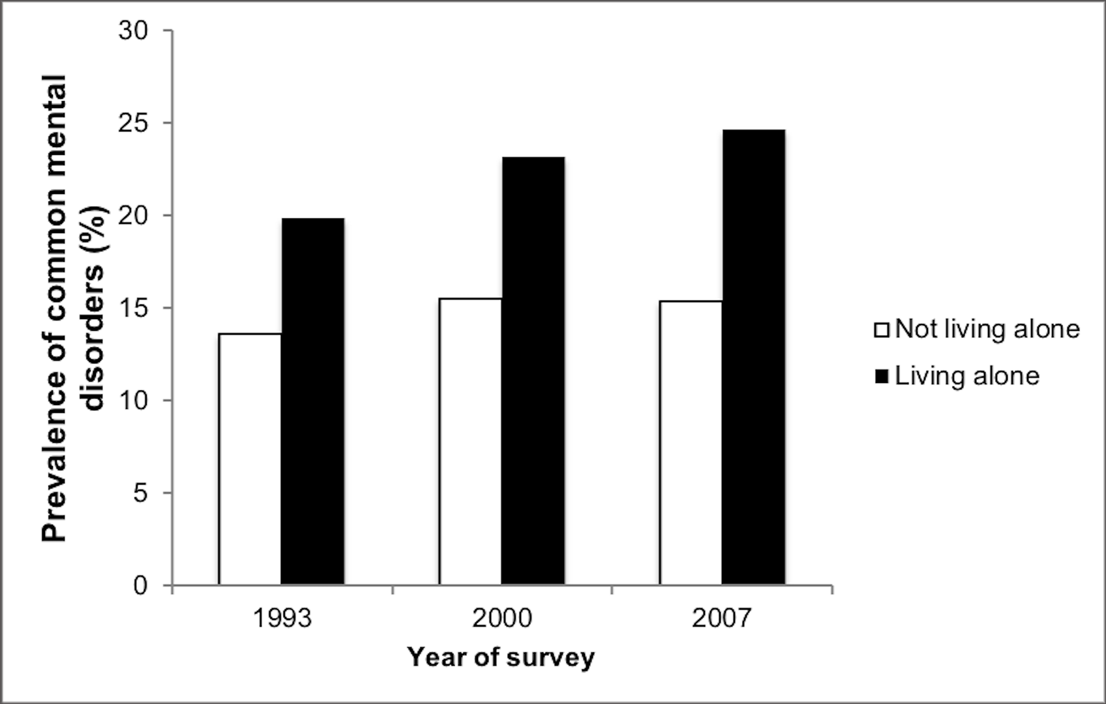
Problem Statement
In United States, 78.0 million people are estimated as part of the elderly population, over 65 years of age and older. However, along with elderly population, a study have revealed that living alone can lead to the development of depression, obesity, drug usage and other harmful habits or mental disorders.
A study by Louis Jacob, Josep Maria Haro, and Ai Koyanagi shows that loneliness explained 84 percent of common mental disorders for those living alone. The study concludes addressing loneliness among individuals living alone is particularly important for the mental wellbeing of this vulnerable populations
Prevalence of common mental disease
Benjamin M. Statler College of Engineering and Mineral Resources

Slide 5
Solution
The solution our group approached to solve this social issue was to develop companion robot, Ball Buddy,
The purpose of Ball Buddy is to give the person a companion while they are living alone.
Ball Buddy is a remote controlled rolling robot that is able to be controlled via an Android application.
Ball Buddy’s size and friendly appearance aims to comfort the user and make them feel as though they aren’t alone.
Benjamin M. Statler College of Engineering and Mineral Resources

Slide 6
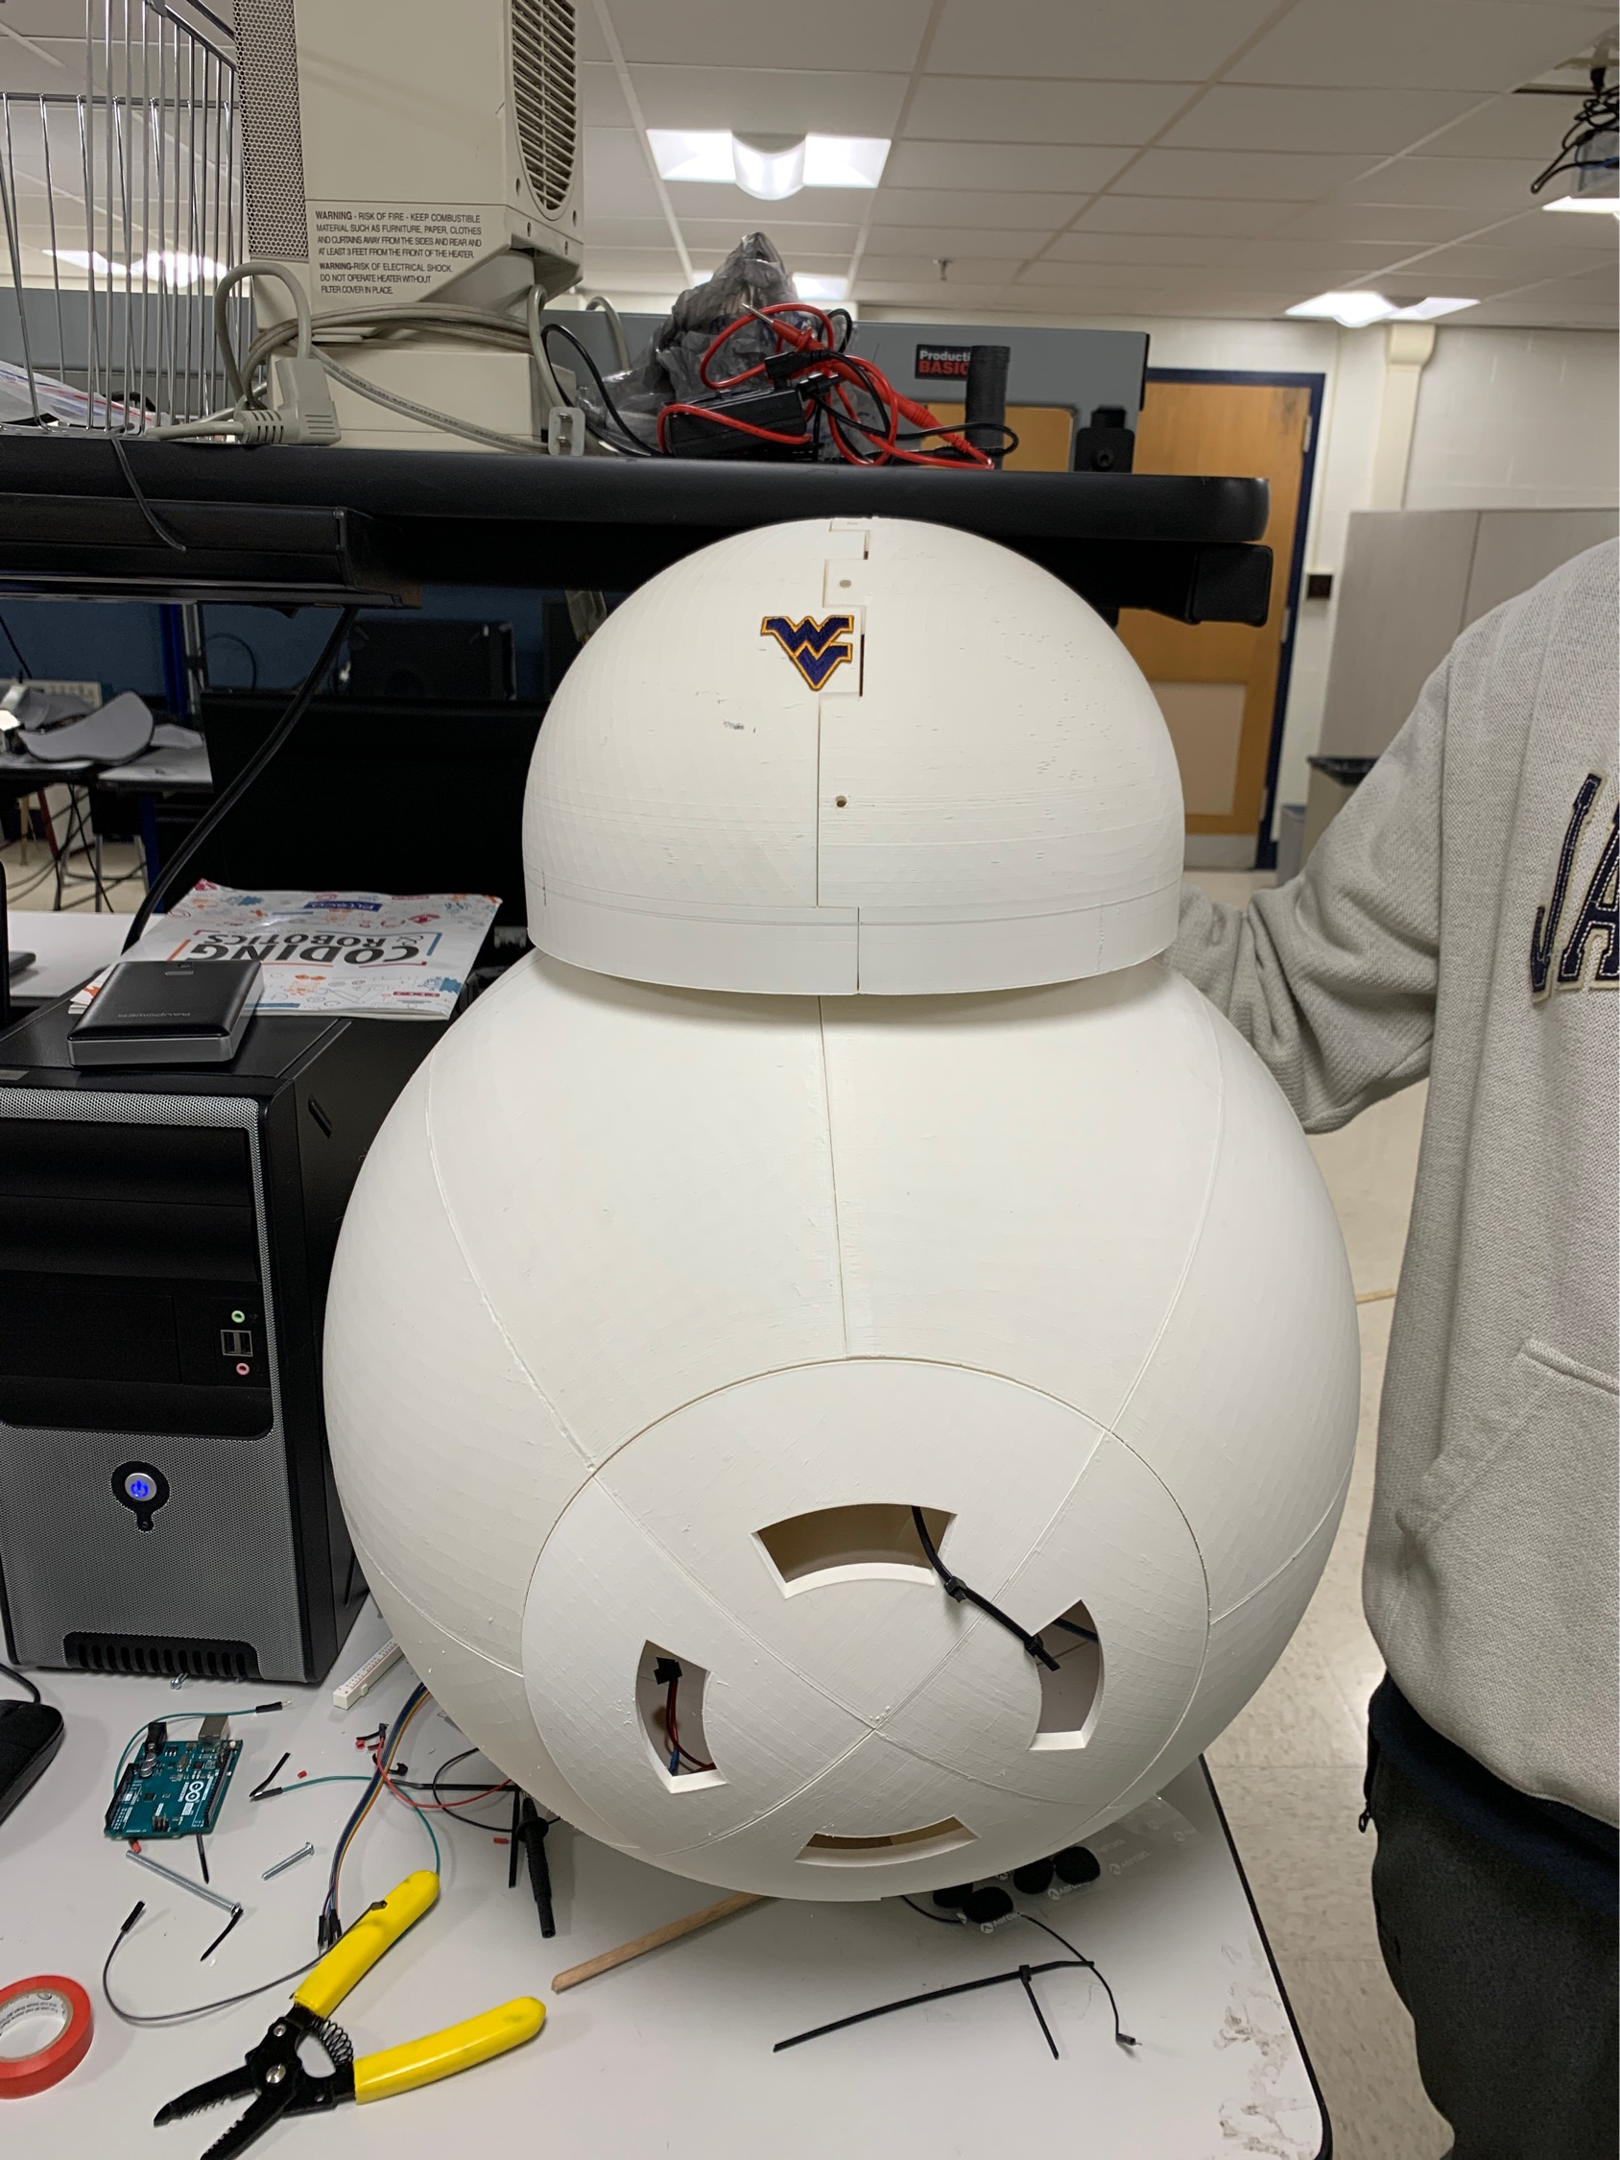
The Current Ball Buddy
The Current Ball Buddy highlights following Features:
Durable, Efficient and replaceable body panels
Connects with bluetooth via using Android application
Drive forward, backwards, turn left and right controlled by user
Stream video from the camera on its head while driving
Features dance functions upon user’s request
Standard
4x3
Benjamin M. Statler College of Engineering and Mineral Resources

Slide 7
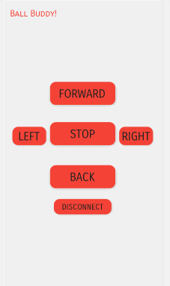
User Interface
After connecting to the bluetooth, the left screen will be shown to users.
Users can easily click functions they want to implement by touching the screen.
User interface is designed simple, easy, and big for elderlies for easy usage even with the hand tremor or vision problems.

Slide 8

Demonstration

Slide 9
Limitations
The 3d-printer used to craft the components was far too small to properly accommodate the amount of material needed to craft the outer shell. The poor quality printer had also left many deformities on the panels. Some panels have very clear printing errors that had to be reinforced through other means.
While this route was far better than our predecessors’ method, any future groups attempting this project should seek out the best possible 3d-printer available to them.

Slide 10
Future works

Slide 11
Work with Fall Detection Team
The current solution for fall detection was modified to utilize the camera from the head allowing users to explore and identify objects while driving the robot by checking the screen.
However, the robot will perform stronger if the future group work with the fall detection team and utilize the fall detection. Detecting users fall with the camera on its head will allow to send messages or emails to user’s family in emergency and be more supportive for elderly users.

Slide 12
Update functions
Moving functions can be updated to achieve more smooth motions by modifying the current code.
Add speaker and add more sounds to the robot to maximize the user friendliness. Not only sounds for Bluetooth but sounds for error notifications or battery warning sounds will be helpful for the user.

Slide 13
Create an application for iOS
In 2017, 728 million people were reported to use Apple iPhone devices [3].
The current application is limited for Android users. This limitation can be easily fixed by creating application for iOS system as well.

Slide 14
Security
Add login system will enhance security.
Enable each account to add phone numbers of their family or close neighbors and send emails or text messages to the contacts of the user to notify the emergency situation.
The database would be needed to store each user’s information and it needs to be secured so that none of the information could be stolen. Securities needs to be enhanced along with the fall detection function in order to store user’s emergency contacts that will be notify others.

Slide 15
Develop Artificial Intelligence
In order to maximize the comfort to users, develop Artificial Intelligence (AI). Associating with AI will enable Ball Buddy to learn many behavior of the users and shows more connections to the users. It will maximize its ability of being companion to the users.

Slide 16
Conclusion
Ball Buddy is an aging in place solution for elderlies with great potential.
The current Ball Buddy can demonstrate moving functions, dancing functions, and provides camera screen for users. The development was started from scratch, and unique outer pieces for the ball design was accomplished.
Numerous of changes can be applied to the robot thanks to its replaceable panels. The potential changes that can benefit the users have been outlined which is also beneficial to Ball Buddy to achieve our goal to present a great companion to elderlies.
Benjamin M. Statler College of Engineering and Mineral Resources

Slide 17
Questions?

